Slide 1
Panther Plus Fuel Saving Device

Slide 2
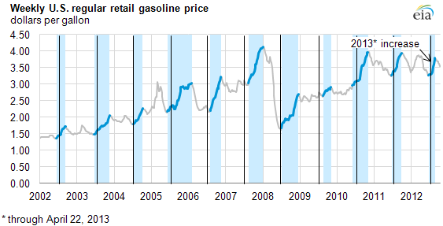
Petrol Crisis – never ending ガソリン価格の高騰ー天井知らず
Prices of petrol had been increased sharply since 10 years ago.
170%

Slide 3
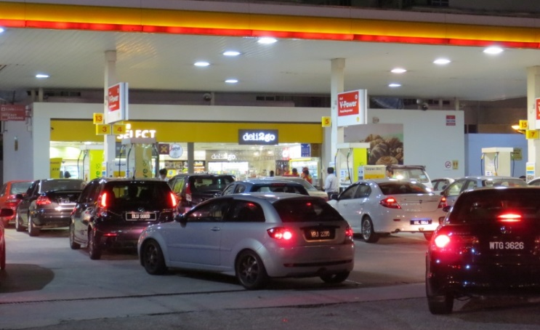
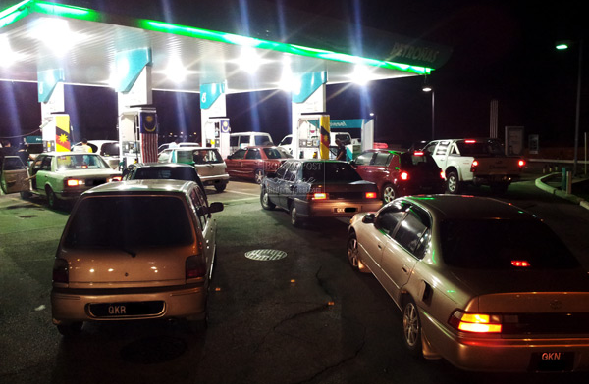
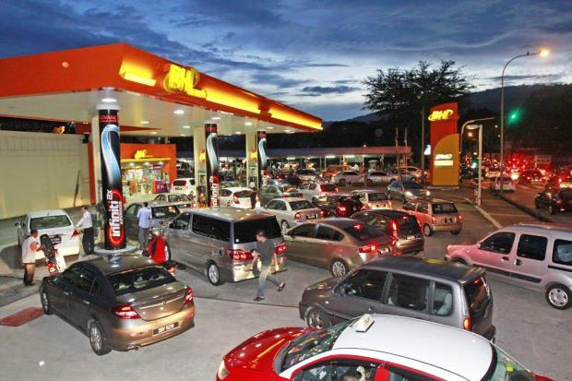
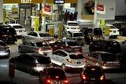
If you take action for a one time 10% saving もし１０％ガソリンの価格が明日上昇するとしたら…
When petrol price increases by 10% tomorrow…

Slide 4
A Brilliant Invention 「パンサー」開発者の紹介
Panther was invented by Mr Hisashi Uto
We can’t reduce the petrol price but
we could help you to save

Slide 5
The Inventor 「パンサー」の開発者プロフィール
Currently, he is a factory automation designer, specializing in auto quality checks and measurements, and CCD auto positioning systems for the automotive industry.
He also lectures at CHUBU Center, under Japan’s Employment and Human Resources Development Organization.
Mr. Uto is a certified CE and ISO consultant for the safety standards.
Panther was invented by Mr Hisashi Uto, an Engineer by profession.
His credentials include the following:
Assigned in the Communication Squadron of Japan Air Self-Defense Force
(JASDF) in the area of high altitude surface to air missile (Nike) guide system.
His major tasks were to set up and maintain the communication network and the
radar system.
Attached to a metal stamping machine manufacturer, his main charge was in
automation control or factory automation which involves sequencer
designs in production lines.

Slide 6
Your Vehicle’s ECU ＥＣＵの働き
Introduced in the 80s, the
Engine Control Unit or ECU is a powerful computer on most vehicles.
ECU’s functions includes:
Gathering data from different sensors & perform calculations
Managing the emissions and fuel economy of the engine
Its objective is to ensure the lowest emissions and
best mileage for your vehicle.

Slide 7
The battery stores electricity at 12v though
the alternator produces 14v while it is running.
The ECU’s baseline voltage is 13.5v
In most cases it stops momentarily
when voltage falls below the setting.
The alternator’s electrical supply falls short during heavy loading such as low revving, higher air-conditioner demand and when mass electrical devices are used simultaneously.
At such, the battery supplements the short fall in electrical supply However, the ECU’s function is suspended temporarily
This is when the
Panther fills the gap for the ECU to keep functioning
as intended, hence the vehicle achieves optimum performance.

Slide 8
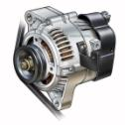
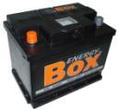
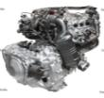
How Panther Works 「パンサー」の技術
Alternator generates 14v electricity whilst engine is running
Sound system
Electricity is distributed to the vehicle’s electrical systems
12v
The battery stores electricity upto 12v
Entertainment system
12v
12v
12v
Cooling/heating system
Panther patches the electrical flow to the ECU during heavy loading, ensuring it receives min 13.5v when required
13.5v
ECU
Car engine

Slide 9
What could do for you? 「パンサー」の効果
Panther
SPEED
SMOOTHNESS
Reclaim 3~5 horse power; 5~10 torque
Driving Pleasure
Up to 25% fuel saving
SAVINGS

Slide 10
About Panther… 「パンサー」の詳細
Suitability
Panther Plus
Platinum Series
Marking
Warranty
Petrol
Diesel
NGV (gas)
12 V to 48V
ONE YEAR manufacturer defects warranty
Vehicle capacity
up to 48v, including busses and trucks
Certificate of Ei
Passed all safety tests
Easy
Just plug into the phone charger socket,
A Green LED will light up.
Optimum Performance
Patented & Trademark Registered
Reset by unplugging and plugging Panther every month for 5 minutes while engine running
Proven
Reached 40 Countries and is still growing
RAPIDLY
2009

Slide 11
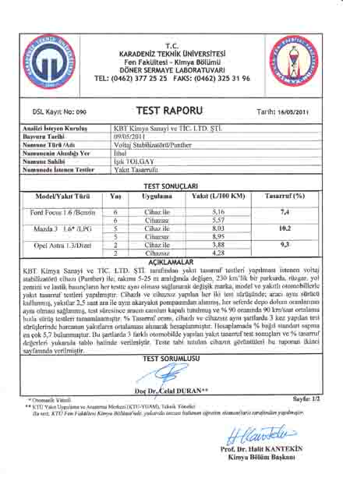
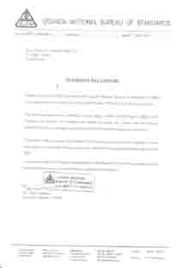
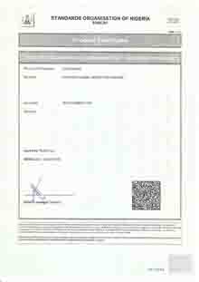
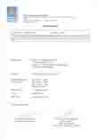
Entry Tests to various countries
様々なテストレポート
Uganda National Bureau of Standards
Functional Test
Standards Organisation
of Nigeria
Africa Countries
Compliance Tests
EUROPE
CE Marking
Compliance Tests
Turkey
Karadeniz Technical University
Functional Test
Turkey
Karadeniz Technical University
Functional Test

Slide 12
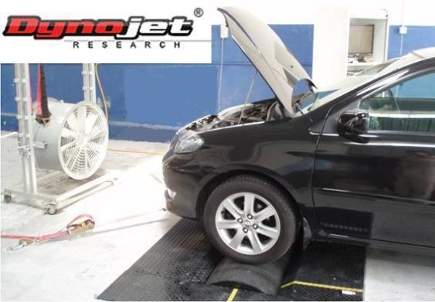
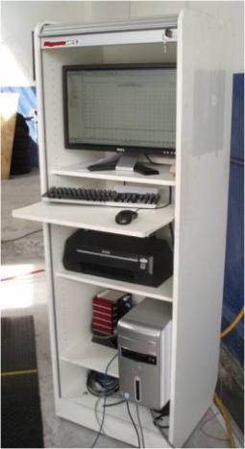
DynoJet Performance Test
ダイノテスターによる検証
A car is being tested for its torque and power performance using the Dynojet’s Automotive Dynometer.

Slide 13
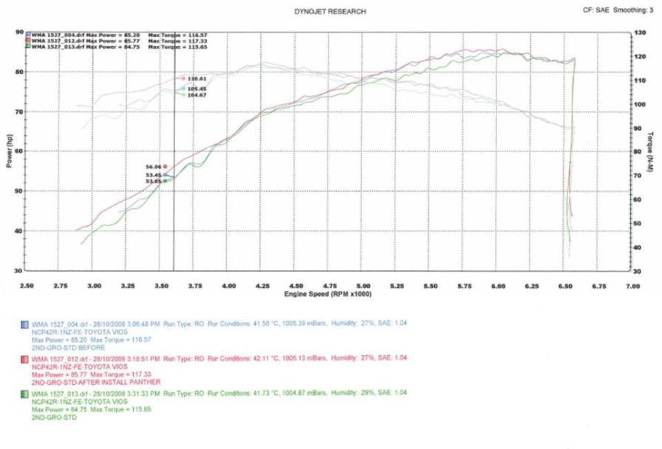
DynoJet Test Report
テストレポート
Torque
Power
With Panther: Increased Power and Torque, and improved smoothness
Without Panther
With Panther
Without Panther

Slide 14
Testimonials
ユーザーの声
Bill Wandera, Exclusive Dealer (Nigeria, Uganda, Tanzania, Kenya, Burundi & Rwanda)
The Panther technology is just amazing. How could a small device save fuel and give your car more power? Believe it or not, Panther does and it’s growing big in the African nations.
The Uganda National Bureau of Standard, Petroleum Laboratory, tested Panther on 2000rpm running idle on 1.8 litre vehicle with a 47% savings.
Alan Wilson, Exclusive Dealer (Ireland)
The Mercedes Taxi driver reported a 21% savings. Just imagine the savings on long run with USD2.50/litre of petrol here.
Kittisak, Authorised Dealer (Thailand)
I have tested Panther on my new Chevrolet SUV and the saving is around 20%...
Soren, Authorised Dealer (Europe)
I had tested Panther on my CDI B180 Mercedes; minus 3 degree Celsius at night; the saving was 41.91%. I had tested on more than 10 over cars personally and the average saving is around 26%.
Mevyn, Authorised Dealer (Mauritius)
I see Panther as a very good product with on going huge potential with fuel prices again increasing at the pump…

Slide 15
On-Road Test
テスト結果
Model | Car Age (Yr) | Panther | Traveled KM | Litre of Petrol | KM/Litre | Savings
Myvi 1.3 | 1.7 | Without With | 44.7 44.6 | 2.98 2.44 | 15.00 18.31 | 22.1%
Toyota Vios 1.5 | 2 | Without With | 42.5 42.5 | 2.61 1.98 | 16.85 22.22 | 31.8%
Myvi 1.3 | 3 | Without With | 44.3 44.3 | 3.42 2.70 | 12.98 16.40 | 26.3%
Merc E280 2.8 | 11 | Without With | 44.9 44.9 | 3.49 2.86 | 12.86 15.69 | 21.9%
Merc CLK 2.6 | 5 | Without With | 87.5 87.6 | 8.83 7.58 | 9.91 11.56 | 16.6%
Mazda 6 2.3 sports | 1 | Without With | 79.5 79.5 | 6.23 5.72 | 12.7 13.9 | 8.9%
Fuel Savings
Panther saves up to 25% fuel on average, varying from vehicle to vehicle.

Slide 16
Now Panther has reached more than 40 countries
E-Bio
AUSTRALIA
BELGIUM
BOSNIA
BRUNEI
BRAZIL
BURUNDI
CANADA
CHINA
CYPRUS
EUROPE UNION
FRANCE
GHANA
GUATEMALA
GREECE
HONDURAS
HONG KONG
INDIA
INDONESIA
IRAN
IRELAND
JAPAN
KOREA
KENYA
MACAU
MALAYSIA
MAURITIUS
NEW ZEALAND
NIGERIA
PHILLIPINES
PAKISTAN
RWANDA
SAUDI ARABIA
SINGAPORE
SOUTH AFRICA
SPAIN
SRI LANKA
SWEDEN
SYRIA
TANZANIA
THAILAND
TURKEY
U.A.E.
UGANDA
UNITED KINGDOM
MIAMI, U.S.A.
VIETNAM
ZAMBIA

Slide 17
More than 1 billion people are facing the same problem １０億人以上の人口が同様の問題を抱えています
The market is HUGE

